Slide 1

Time and Space Complexity

Slide 2

What is time complexity?
Time complexity is a way to measure how the runtime of an algorithm increases as the size of the input grows. It helps us understand the efficiency of our code and its scalability, giving us a clear view of how an algorithm performs in different scenarios.
What is space complexity?
Space complexity measures how the amount of memory an algorithm uses grows with the size of the input. It includes both the space for input values and any additional space created during execution, helping us optimize resource usage in our programs.

Slide 3
Why is Big-O notation important?
Big-O notation is crucial because it provides a high-level understanding of an algorithm's efficiency. It helps us predict how quickly an algorithm will run and how much memory it will require as input sizes grow. By mastering Big-O, you can make informed decisions about which algorithms to use in different scenarios.
Other Notations
Big O (Upper Bound)Describes the maximum amount of time or space an algorithm uses
Big θ (Exact)Describes the exact amount of time or space an algorithm uses
Big Ω (Lower Bound)Describes the minimum amount of time or space an algorithm uses

Slide 4
Common time complexities in Big-O
Time complexity is usually expressed using the Big O notation, which is a mathematical notation that describes the upper bound of an algorithm‘s execution time. The most common time complexities are:
O(1) - Constant time complexity (the algorithm takes the same amount of time regardless of the input size)
O(log n) - Logarithmic time complexity (the algorithm takes time proportional to the logarithm of the input size)
O(n) - Linear time complexity (the algorithm takes time proportional to the input size)
O(n log n) - Linearithmic time complexity (the algorithm takes time proportional to the product of the input size and its logarithm)
O(n^2) - Quadratic time complexity (the algorithm takes time proportional to the square of the input size)
O(2^n) - Exponential time complexity (the algorithm takes time proportional to 2 raised to the power of the input size)

Slide 5
Common space complexities in Big-O
Space complexity refers to the amount of memory an algorithm uses, usually measured in terms of the amount of memory required to store the input(input space) and any additional data structures(auxiliary space) used by the algorithm. It's a way to describe how much memory an algorithm uses, relative to the size of the input.
Space complexity is also usually expressed using the Big O notation. The most common space complexities are:
O(1) - Constant space complexity (the algorithm uses the same amount of memory regardless of the input size)
O(n) - Linear space complexity (the algorithm uses memory proportional to the input size)
O(n^2) - Quadratic space complexity (the algorithm uses memory proportional to the square of the input size)

Slide 6
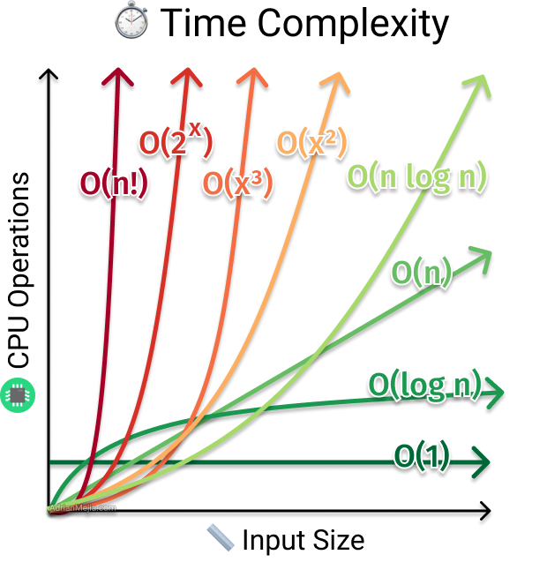

Slide 7
Understanding worst, best, and average cases
The worst-case scenario is the maximum amount of time or space that an algorithm might take, while the best case is the minimum. Average case lies between these two extremes and depends on the most typical input. Recognizing these variations helps you get a realistic picture of an algorithm's performance.
if score >= 90: return 'A'
elif score >= 80: return 'B‘
elif score >= 70: return 'C'
elif score >= 60: return 'D'
else: return 'E‘
Input 30??
Input 90??
Do you want to make system for one person or million person?

Slide 8
Why we need to understand time and space complexity?
In the world of computer science, efficiency is king. When we design algorithms, we want them to be fast and use as little memory as possible. This is where time and space complexity come in. Time complexity tells us how long an algorithm takes to run as the size of the input grows. Space complexity tells us how much memory an algorithm needs to run. By understanding these two concepts, we can choose the best algorithms for the job and make sure our programs run smoothly. We need to understand the concept for:
Accurate estimation of algorithm performance
Comparison of algorithms
Optimization of algorithms
Prediction of algorithm scalability

Slide 9
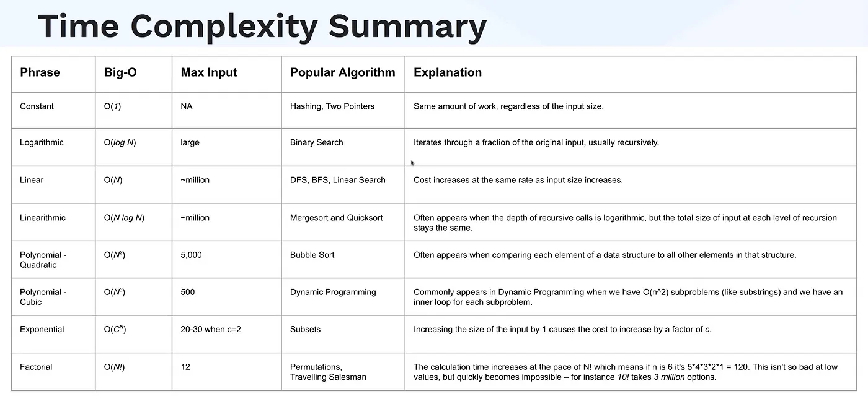

Slide 10
Thank you!
Do you have any questions?
Reach me by clicking
zohadijaz786@gmail.com

